Slide 1

IMAGE PROCESSING WITH SIFT
Assignment 5
Nicola Gugole
Matricola: 619625

Slide 2
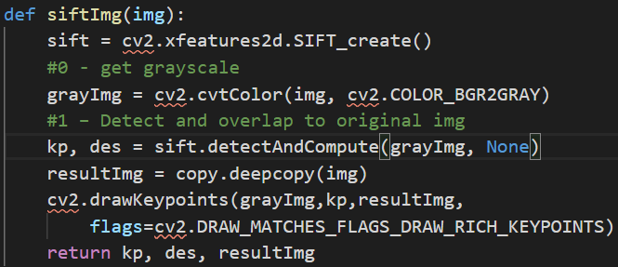
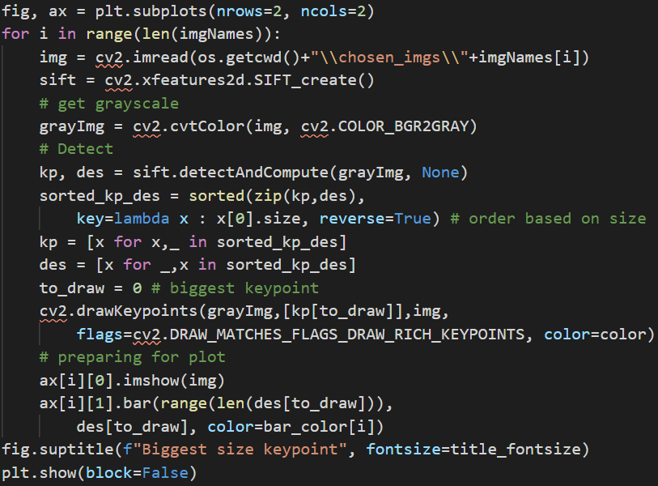
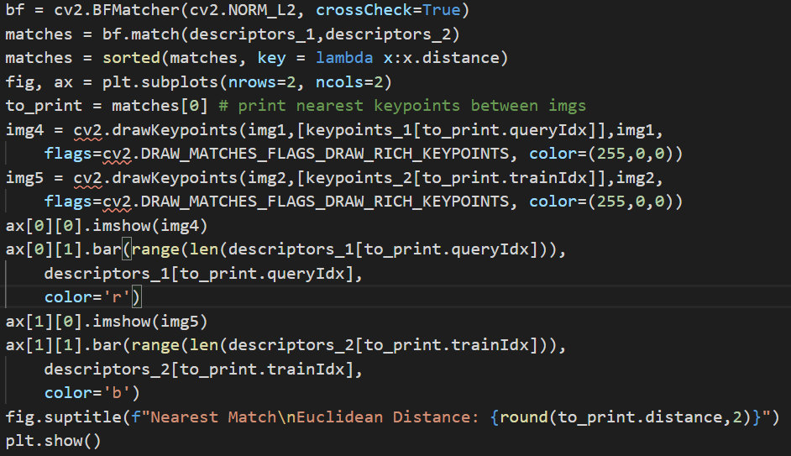
Basic Keypoint Detection, Description
Fun Fact: Keypoint object has size field, but also response (strength), angle of orientation and pt for coordinates access
Drawing Keypoints with Correct Sizes
Biggest Keypoint Selection and Drawing for Visual Comparison
Finding Matching Keypoints and ordering by Euclidean Distance
Drawing Nearest Match and Print Distance

Slide 3
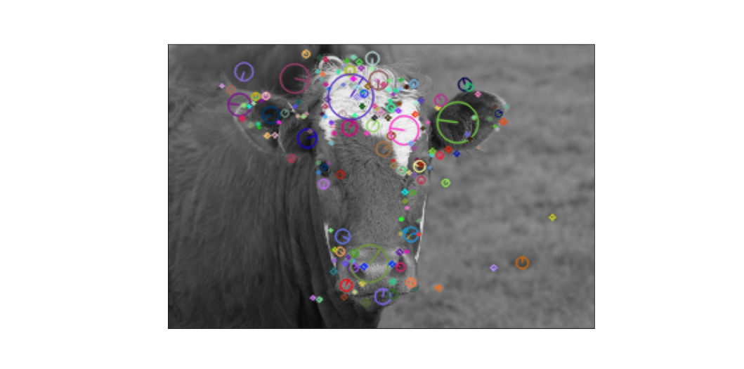
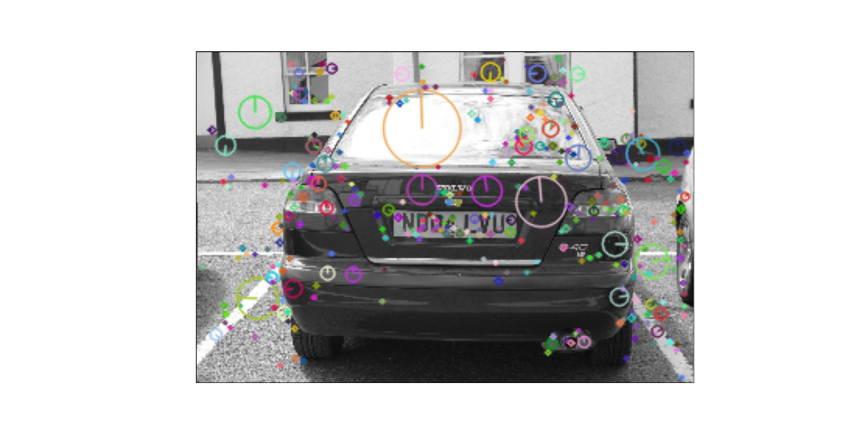
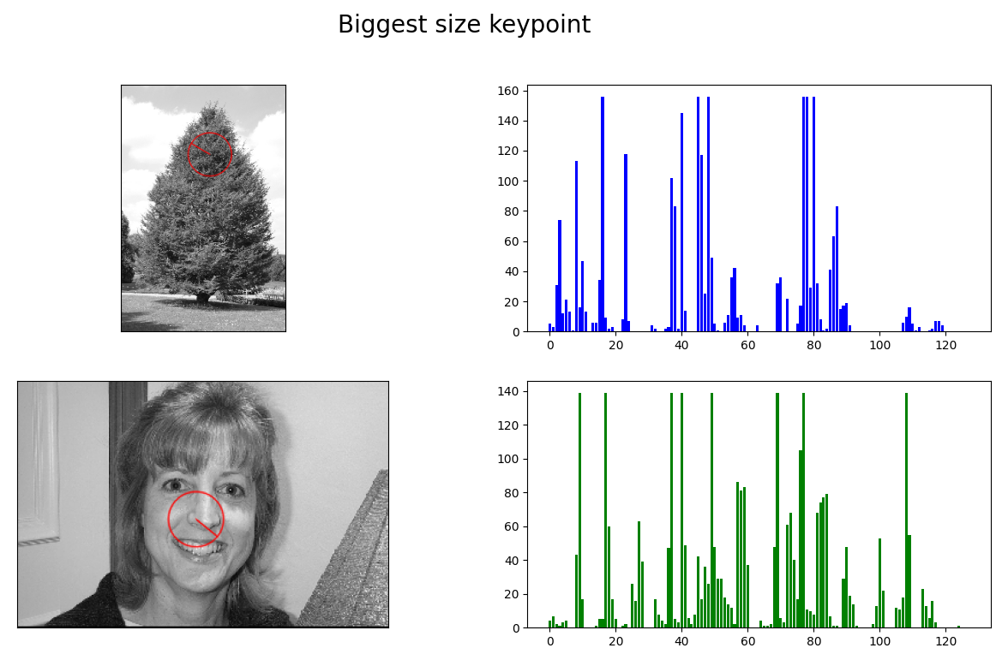
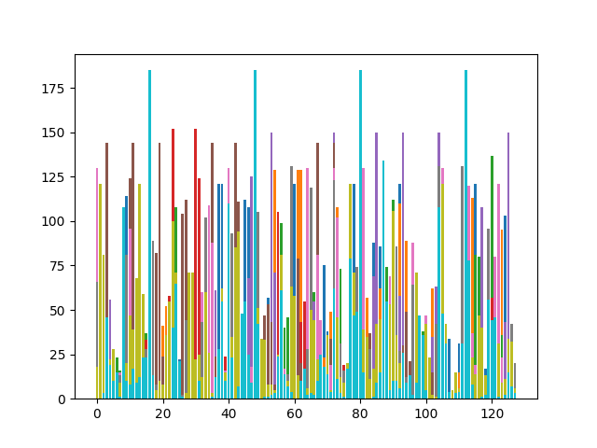
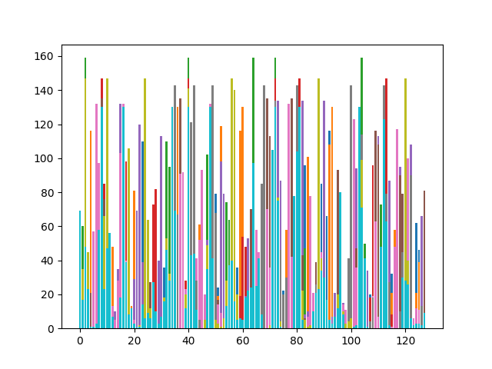
Keypoint Overlapping and Biggest KP Comparison

Slide 4
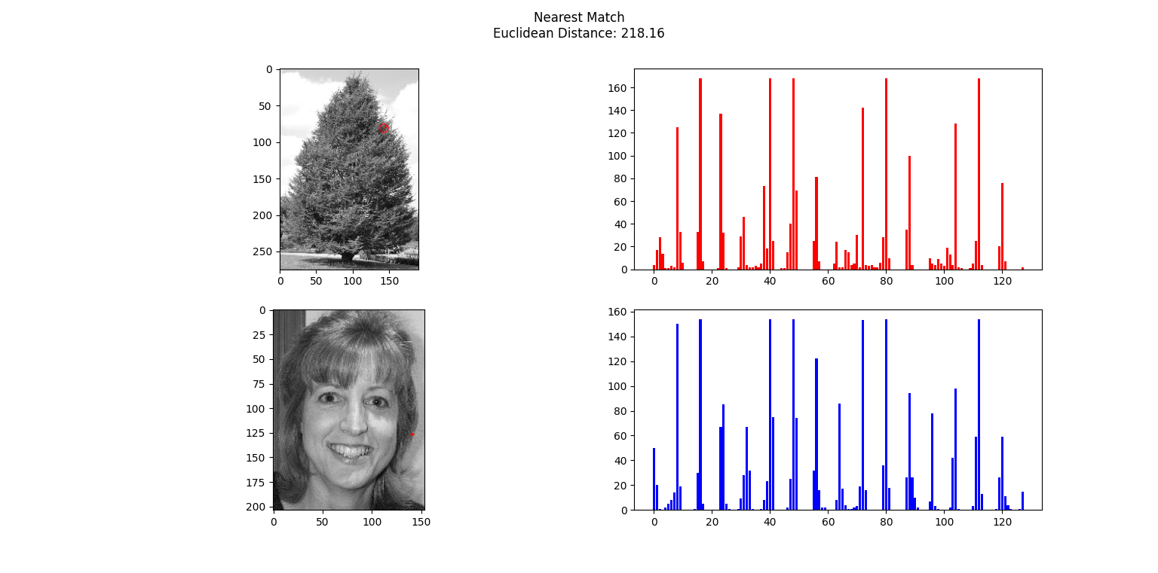
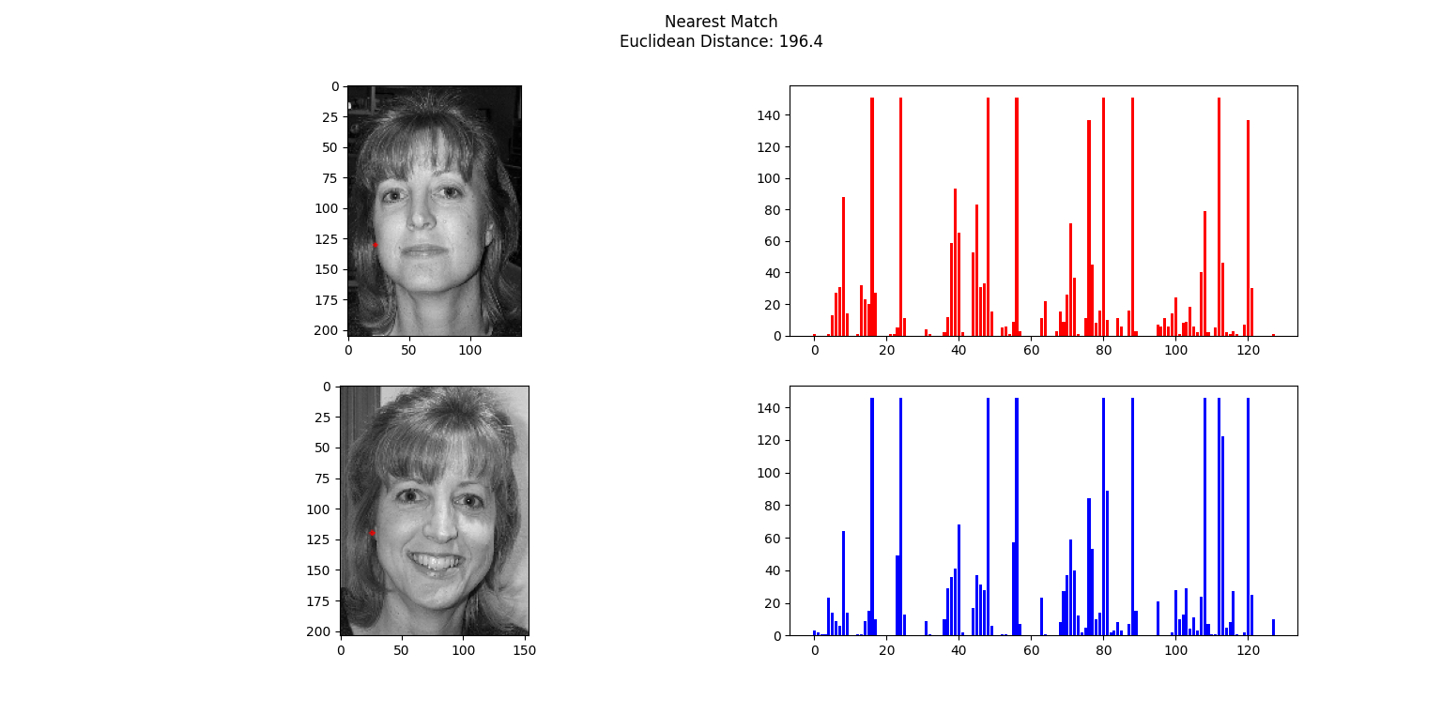
Matching Nearest Descriptors
Extremely different images may have incredibly similar descriptors..
Nearest descriptors in similar images make much more sense.
Single descriptors are NOT enough descriptive of the image, the set of descriptors are what makes the method work!

Slide 5
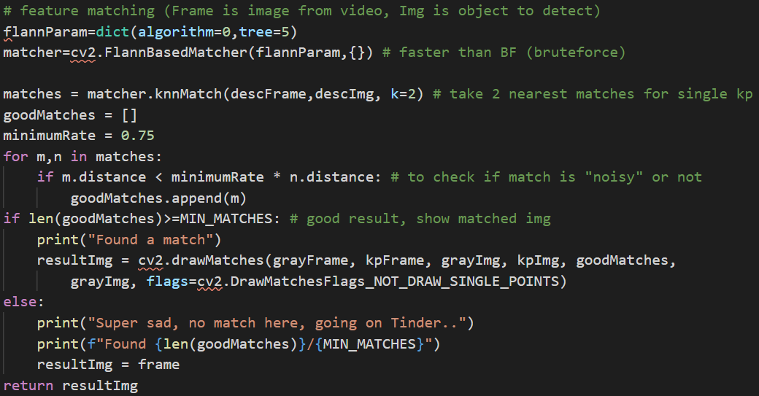
An application: Object Recognition
Key Aspect
Take first and second nearest match for each keypoint, if distance of first one is not much smaller than second one:
BAD MATCH (not a good descriptor)
Find enough GOOD MATCHES and you have recognized the object
Hints and preprocessing for good results:
Crop the image to avoid deceptive keypoints
Use images with details which create descriptors, SIFT needs the raw materials to work!

Slide 6
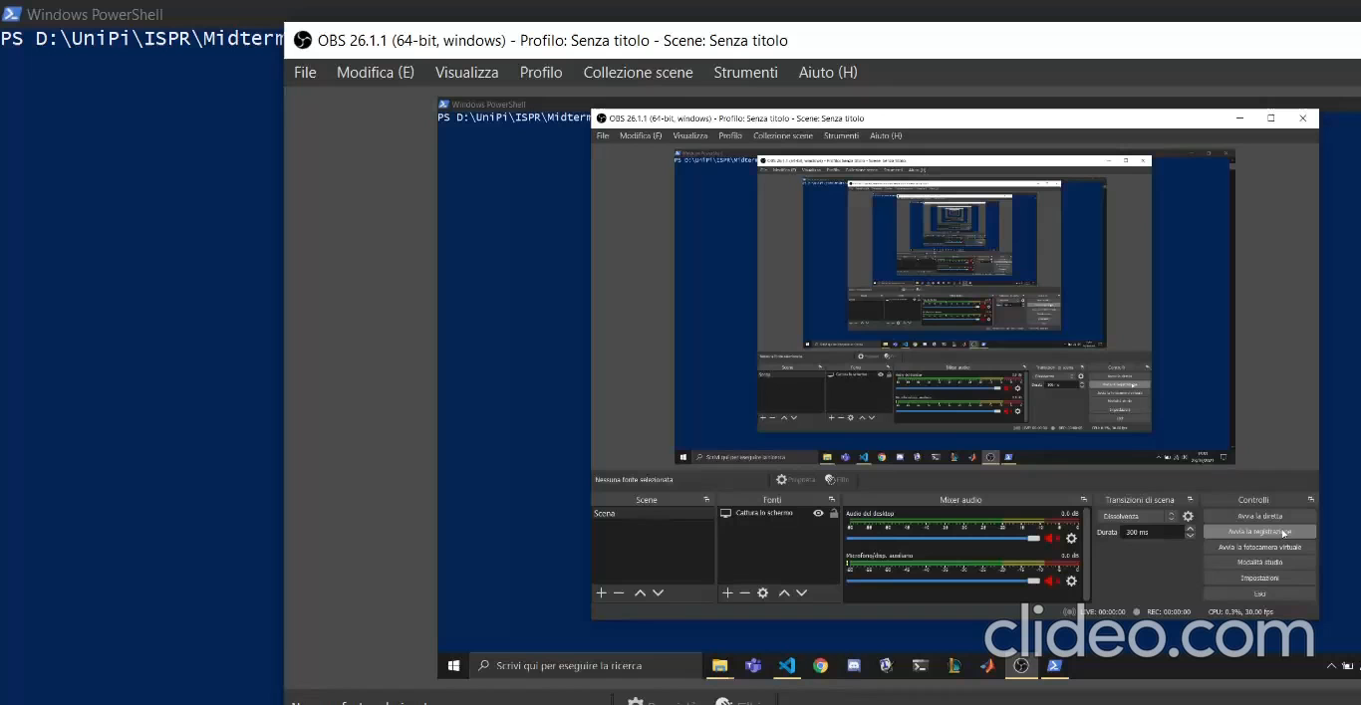
Object Recognition in Practice

Slide 7
Thank you for the attention (for code curiosities, here)

